Slide 1
Apache Kafka and the Rise of Event-Driven Microservices
Jun Rao
Co-founder of Confluent

Slide 2
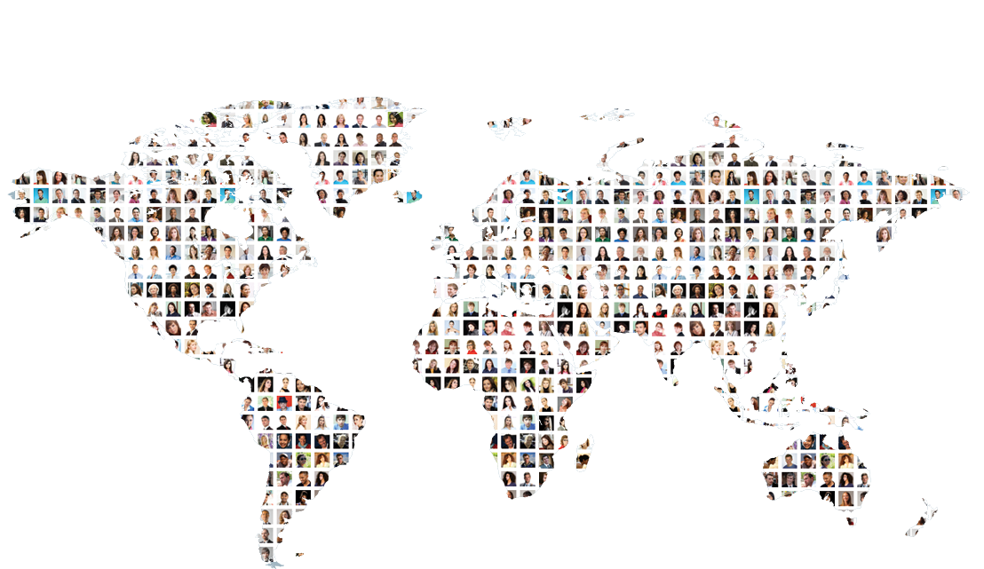
LinkedIn at 2010 : World’s Largest Professional Network
Connecting Talent ⬄ Opportunity. At scale…
200M+
2 new
100M+
2M+
Members Worldwide
Members Per Second
Monthly Unique Visitors
Company Pages

Slide 3
It’s all about data!
Value ↑
User
Product
Virality ↑
Insights ↑
Signals ↑
Data
Science
Notes:
Remove extra circles.

Slide 4
Initial database driven architecture
web
application
web
application
database
Notes:
More non-web data sources

Slide 5
Realization #1: Event > State
State: I work at Confluent
Event: I changed job to work at Confluent
Notes:
More non-web data sources

Slide 6
Event driven microservices
member recommendation
new job
description
search
index
graph
engine
Notes:
More non-web data sources

Slide 7
Realization #2: leverage non-transactional data
Business metrics
clicks, search keywords, pageviews
Operational metrics
requests/sec, request types/sec
Application logs
service calls, errors
IOT
…
Notes:
More non-web data sources

Slide 8
Database a mismatch for both!
Notes:
More non-web data sources

Slide 9
Mismatch #1: no first class API for events
member recommendation
database
SQL
table
SQL
search
index
log
SQL
graph
engine
Tremendous load pressure on database!
Notes:
More non-web data sources

Slide 10
Mismatch #2: not suitable for non-transactional data
1000X more volume
Different transactional needs
Not always needing a relation view
Notes:
More non-web data sources

Slide 11
Danger of Point-to-point Pipelines
Notes:
No shadow.
Make the name more generic.

Slide 12
Ideal Architecture
Notes:
Change data pipeline to Kafka.
Loosely coupled.
Some of them are batched. Some are real time.

Slide 13
1st Attempt: Don’t Reinvent the Wheels
Why not messaging systems?

Slide 14
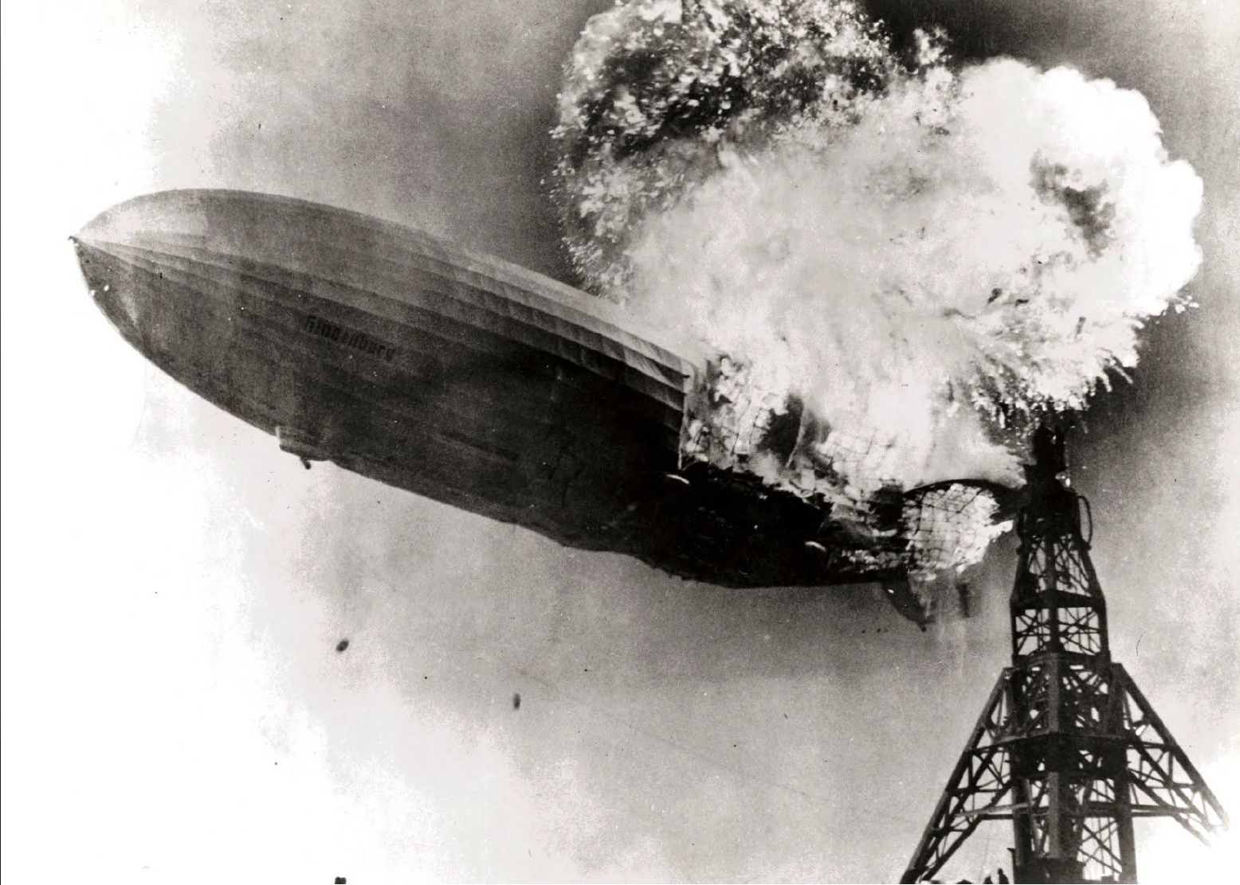

Slide 15
Version 1 of Kafka
High throughput pub/sub
Design 1: make log first class citizen
Design 2: distributed architecture

Slide 16
Design #1: log as first a class citizen
database
table
log
long poll() API

Slide 17
Design #1: log as first a class citizen
Easy to optimize for throughput
database
table
log
long poll() API

Slide 18
Design #1: log as first a class citizen
Persistency for lagging/rewinding consumption
database
table
log
long poll() API

Slide 19
Design #1: log as first a class citizen
Ordered delivery to reduce consumer bookkeeping overhead
database
table
log
long poll() API

Slide 20
Design #2: distributed architecture
producer
producer
producer
Kafka cluster
broker 1
broker 2
broker 3
broker 4
topicA-0
topicA-1
topicA-2
topicA-3
topicB-0
topicB-1
topicB-2
topicB-3
topicC-0
topicC-1
topicC-2
topicC-3
consumer
consumer
consumer
Notes:
Put partitions inside topic?
Maybe useful to use another picture.
3-tier

Slide 21
Kafka at LinkedIn in 2011
28 billion messages/day
460 thousand messages written/sec
2.3 million messages read/sec
Tens of thousands of producers
Every production service is a producer
Data democracy!

Slide 22

Kafka => Apache in 2011
6 of the top 10 travel companies
7 of the top 10 global banks
8 of the top 10 insurance companies
9 of the top 10 telecom companies

Slide 23

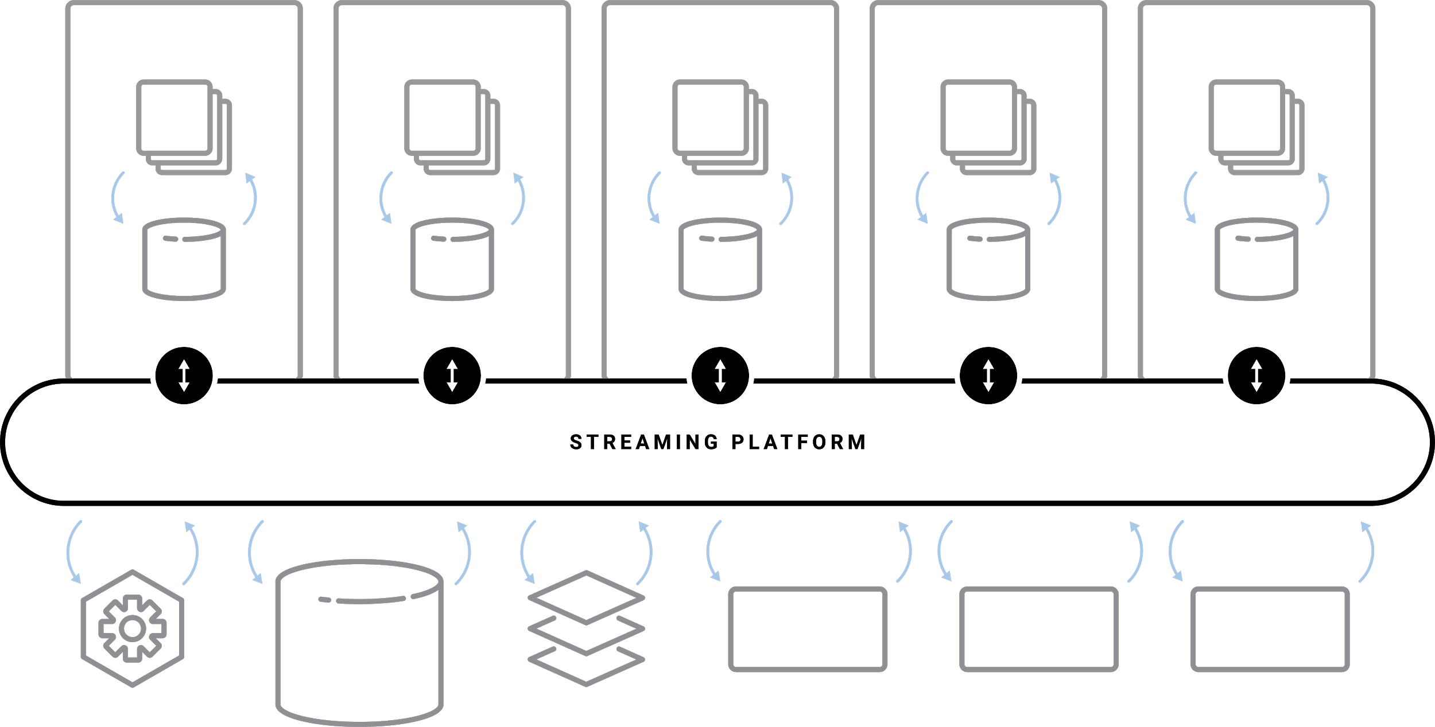
Royal Bank of Canada Event-Driven Banking
Consumer Credit Services
Corporate Real Estate
Investor Services
Treasury Services
….
30+ Use-cases
50+ apps
10+ different lines of businesses
Lowering anomaly detection from weeks to real-time
Data Warehouse
Digital Marketing
Fraud
Security
Microservices
SaaS
Notes:
Banking is transforming pretty rapidly to being event driven. My favorite story of an organization that started with a pre-streaming world and progressed all the way to the central nervous system stage is Royal Bank of Canada. Just a few years ago, they started their streaming journey with the goal of freeing data from mainframes by streaming it into Kafka.
Today they have 30+ use-cases, 50+ applications, across 10+ different lines of businesses, all taping into the central Streaming Platform to power everything from a transformation from mainframe-based monolithic apps to cloud-native microservices without rewriting core systems of record, to lowering anomaly detection from weeks to real-time, and sharing data easily across business units and with business partners.
The Streaming Platform based on Kafka and Confluent are transforming RBC into a modern, event-driven bank.

Slide 24
Carnival cruise line

Slide 25

Building the processing layer
event-driven microservice
Transformation
Enrichment
Aggregation
event-driven microservice
Kafka pub/sub
event-driven microservice
Notes:
More non-web data sources

Slide 26
Kafka Streams
KStream<Integer, Integer> input = builder.stream(“numbers-topic”);
// Stateless computation
KStream<Integer, Integer> doubled = input.mapValues(v -> v * 2);
// Stateful computation
KStream<Integer, Integer> sumOfOdds = input .filter((k,v) -> v % 2 != 0) .selectKey((k, v) -> 1)
.reduceByKey((v1, v2) -> v1 + v2, ”sum-of-odds")
.toStream();

Slide 27
KSQL (from Confluent)
CREATE STREAM vip_actions AS SELECT userid, page, action
FROM clickstream c
LEFT JOIN users u
ON c.userid = u.user_id WHERE u.level = 'Platinum';

Slide 28
Event driven platform
event-driven microservice
transactional
events
kstreams/ksql
database
kstreams/ksql
event-driven microservice
non-transactional
events
kstreams/ksql
Kafka pub/sub
event-driven microservice
Notes:
More non-web data sources

Slide 29
Still interesting work ahead
Scalability in metadata
Streaming database
Cloud integration

Slide 30
Conclusion
The success for business not only depends on software, but how they build software
Apache Kafka offers a new platform than traditional database
This is an exciting time to work on streams

